Slide 1




RET is funded by the National Science Foundation,
Grant # EEC-1710826
2019 Summer NSF RET Project #4
Modeling of Signalized Intersection Design and Impacts
Presented by
Lynn Brant
Kings High School
Girija Nair-Hart, PhD.
University of Cincinnati Clermont

Slide 2

RET is funded by the National Science Foundation,
Grant # EEC-1710826
Outline of Presentation
Background
Goal
Research Activities
Understanding of Basic Concepts
Training Received
Case Study
Result Analysis
Class Implementation Plans

Slide 3
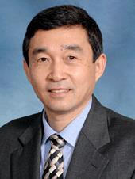
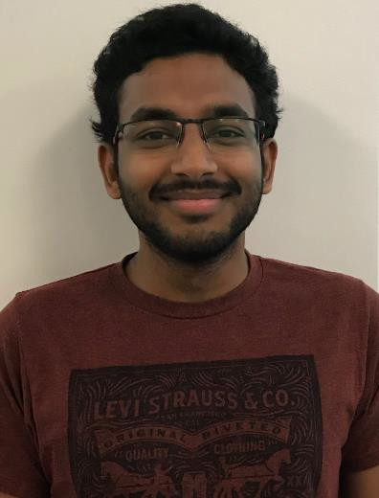
RET is funded by the National Science Foundation,
Grant # EEC-1710826
Our Research Team
Faculty Mentor
Graduate Research Assistant
Heng Wei, Ph.D., P.E. Professor and Director Advanced Research on Transportation Engineering and Systems (ART-EngineS) Laboratory
Mr. Raja Bharat Annam Graduate Research Assistant
U.C. MS Student in Transportation Engineering

Slide 4

RET is funded by the National Science Foundation,
Grant # EEC-1710826
Research Background
Problem Identification: complex of current signalized
intersections -- example of MLK & Jefferson
Big Idea: apply advanced signal control technology
Challenge: understand and create simulation-based practical solution and required analytics
4

Slide 5

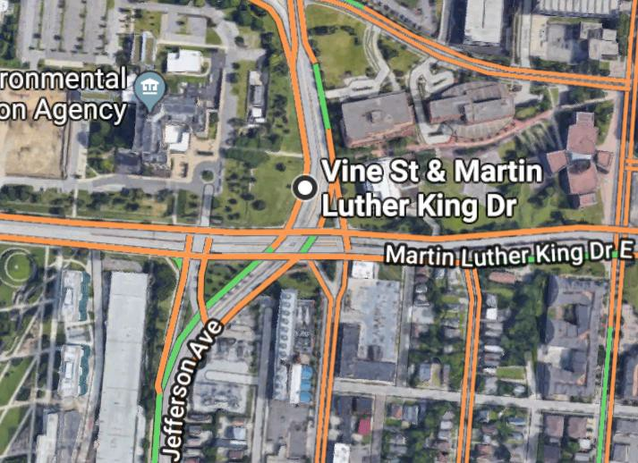
RET is funded by the National Science Foundation,
Grant # EEC-1710826
Research Goal
To investigate the simulation-based method for evaluating the proposed solution to the complex signalized intersection through a case study of the “complex intersection” of Martin Luther King Drive, Jefferson Avenue, Vine Street, and Short Vine Street.
4

Slide 6

RET is funded by the National Science Foundation,
Grant # EEC-1710826
Research Activities
Evaluated existing condition of the studied “complex intersection”.
Proposed solution alternative aiming to improve the operational performance by using delay and level of service.
  Signal phase and timing improvement alternatives
  Roundabout alternative.
Used Simulation Software to evaluate the proposed alternatives.
Develop class implementation plans
6

Slide 7
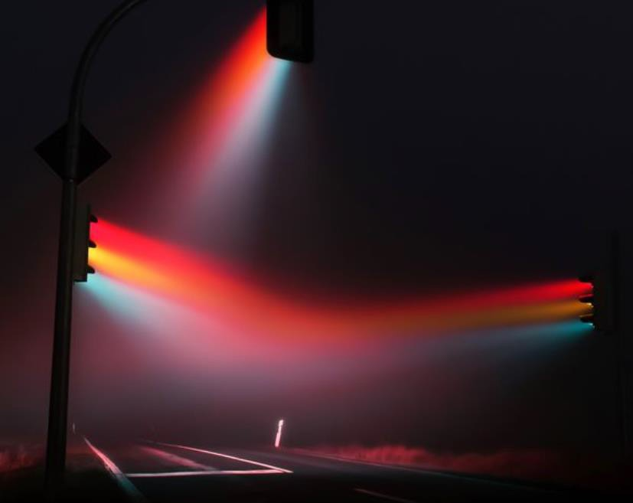
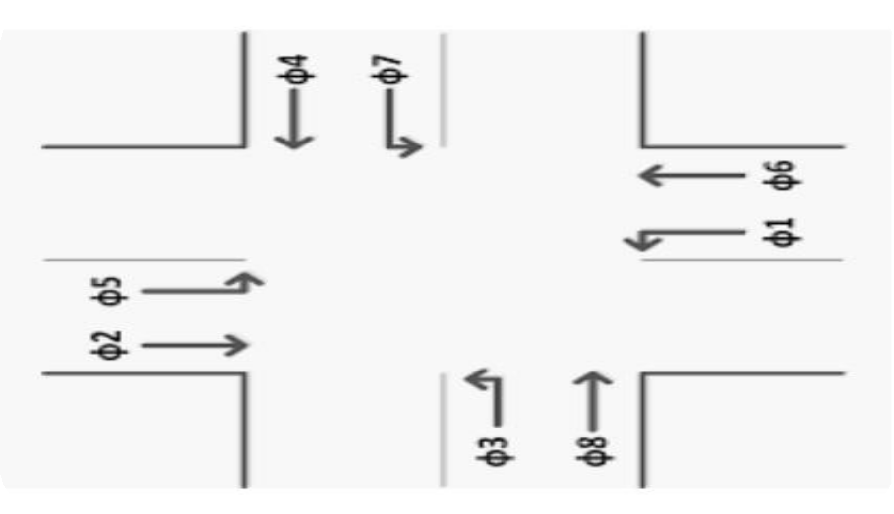

RET is funded by the National Science Foundation,
Grant # EEC-1710826
Understanding of Basic Concepts
Types of Traffic Signals
Pre-timed
Semi – Actuated
Fully – Actuated
NEMA Phasing Convention

Slide 8

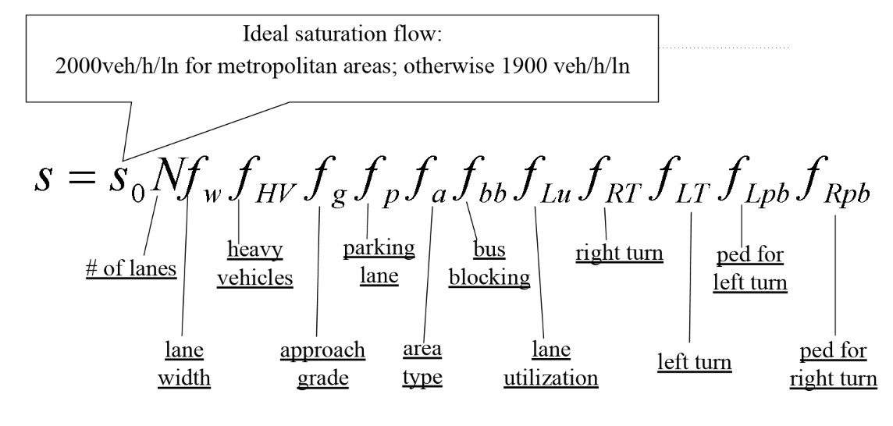
RET is funded by the National Science Foundation,
Grant # EEC-1710826
Understanding of
Basic Concepts
Mathematical Model for Actual Saturation Flow

Slide 9







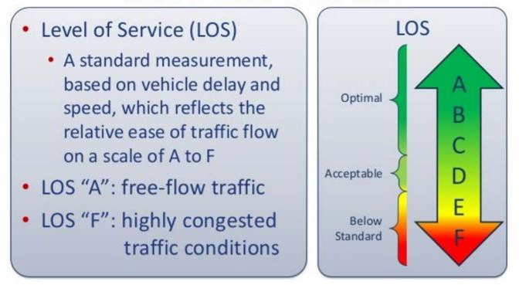
RET is funded by the National Science Foundation,
Grant # EEC-1710826
Understanding of
Basic Concepts
Level of Service (LOS)
(Step function)
Performance Measures
Average Delay
Travel Speed
Level of Service
(LOS)

Slide 10
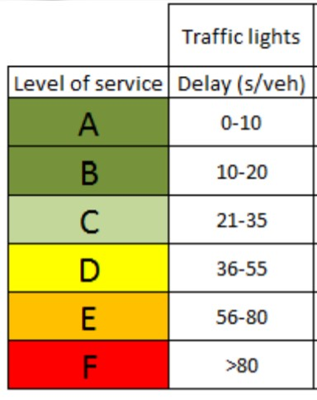
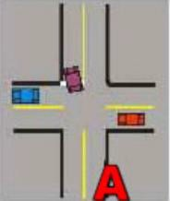

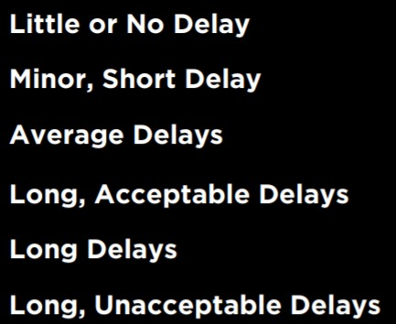

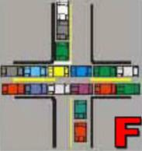

RET is funded by the National Science Foundation,
Grant # EEC-1710826
Understanding of Basic Concepts
LOS Interpretation
10

Slide 11
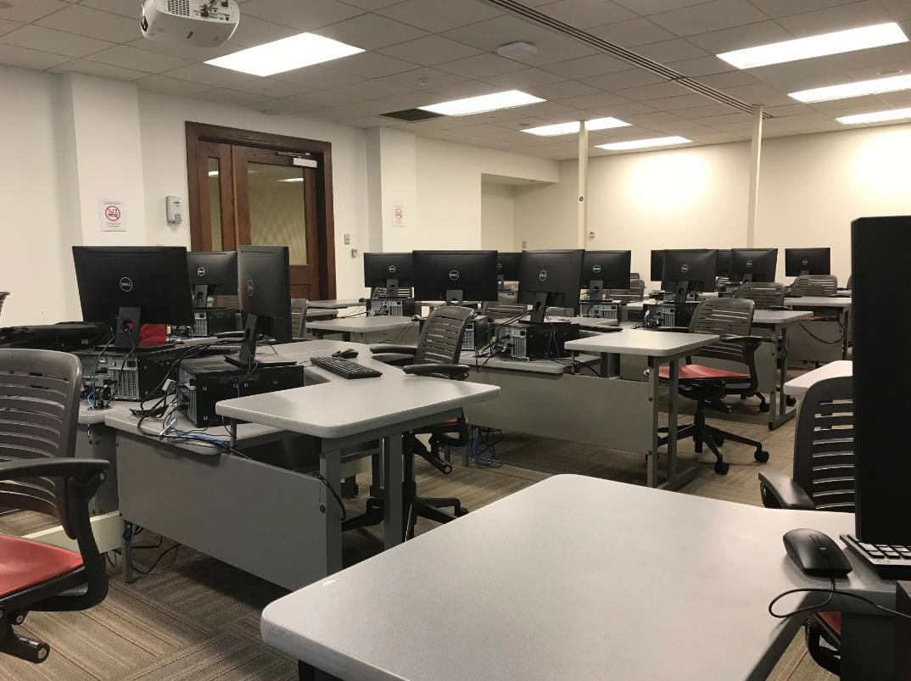







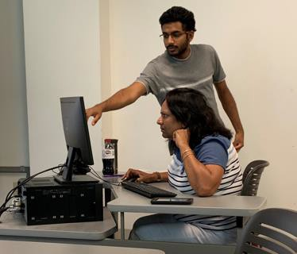
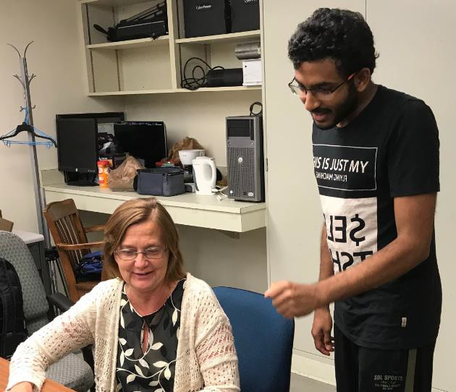
RET is funded by the National Science Foundation,
Grant # EEC-1710826
Software Training Learned from the Project
Highway Capacity Software
Micro-simulation VISSIM 9.0

Slide 12


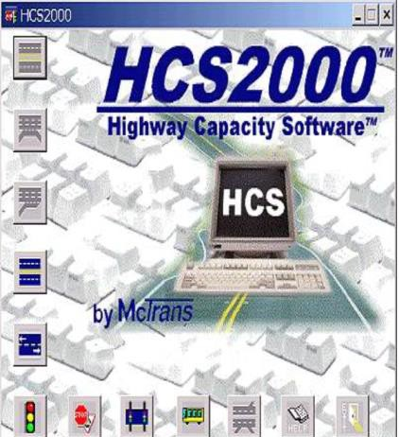
RET is funded by the National Science Foundation,
Grant # EEC-1710826
Software Training
HCS – Highway Capacity Software
Area type
Land details
Grade
Geometric
# vehicles
Base saturation flow rate
% heavy vehicle
Traffic
Cycle length
Green time etc
Type of intersection
Signalization

Slide 13


RET is funded by the National Science Foundation,
Grant # EEC-1710826
Software Training
Vissim Interface
Identify Conflict
Add Signal Control
Areas
Base Data
(all imperial)
Set Route Decisions
Ring Barrier Control
(RBC)
Background Setting
(google map zoom,
Add Vehicle Input
Signal Head
saved files)
Insert Links
Create turn lanes
Detectors, Detectors to RBC
(splines, connectors)
(map out the entire
∩)

Slide 14
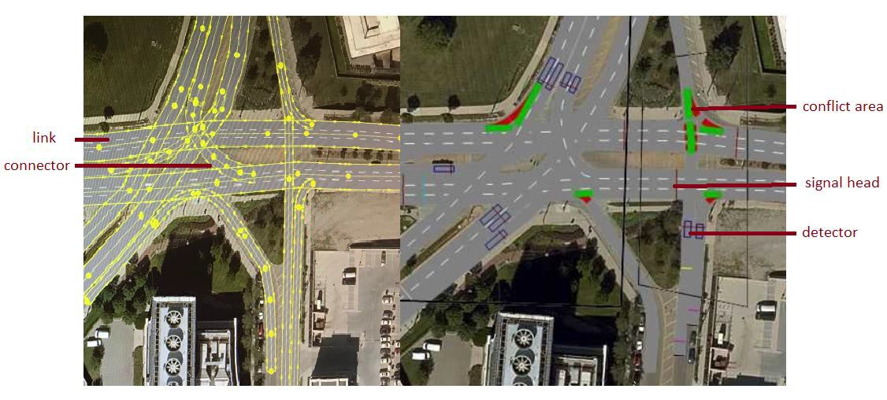

RET is funded by the National Science Foundation,
Grant # EEC-1710826
Software Training

Slide 15
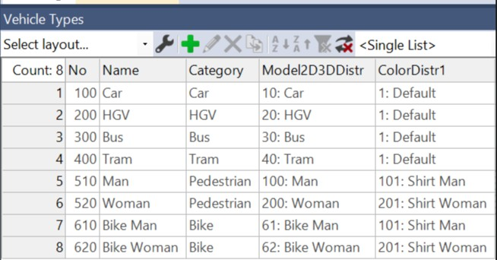
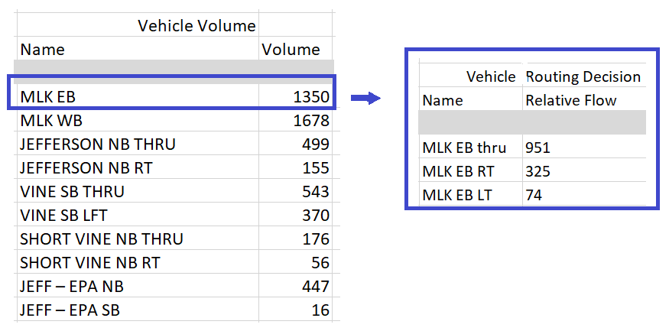

RET is funded by the National Science Foundation,
Grant # EEC-1710826
Software Training

Slide 16
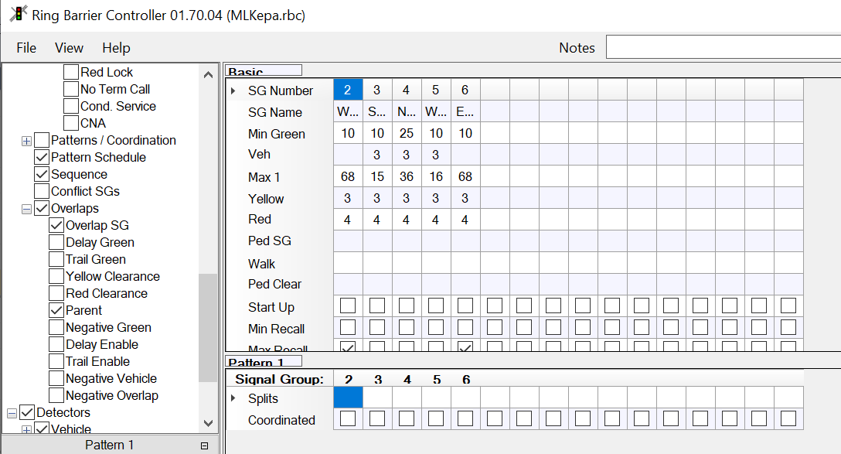

RET is funded by the National Science Foundation,
Grant # EEC-1710826
Software Training

Slide 17
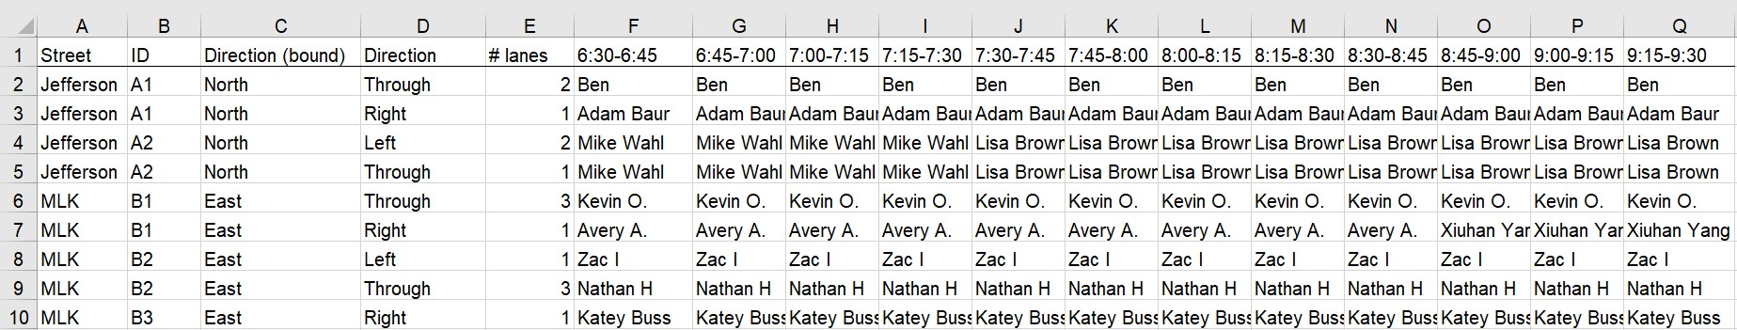
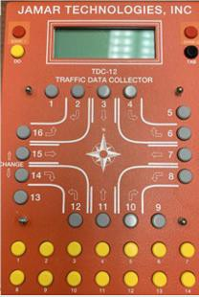
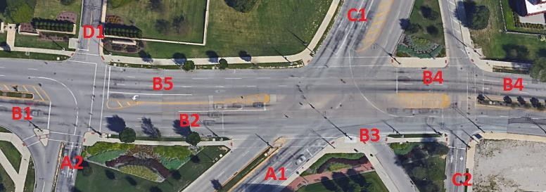
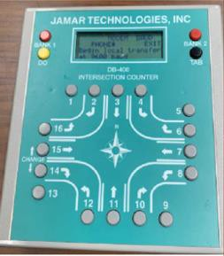

Case Study
Data for Simulation-based Analysis
RET is funded by the National Science Foundation,
Grant # EEC-1710826

Slide 18
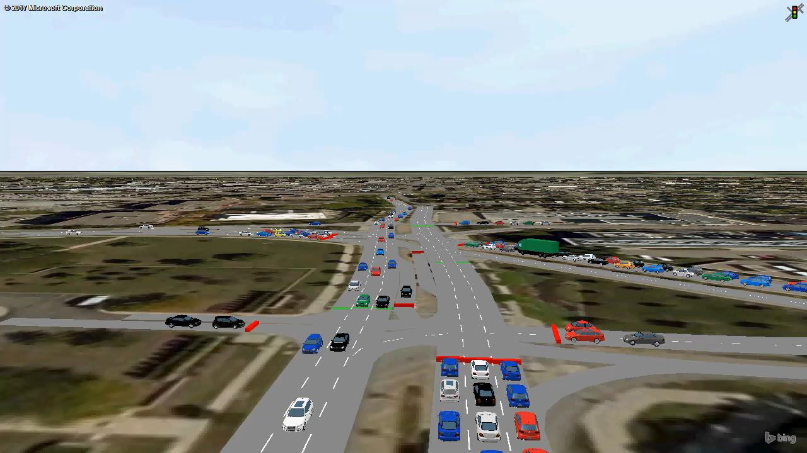
RET is funded by the National Science Foundation,
Grant # EEC-1710826
Case Study
VISSIM Simulation
MLK - Jefferson
  Vine Left Turn
MLK - EPA
MLK - Short Vine

Slide 19

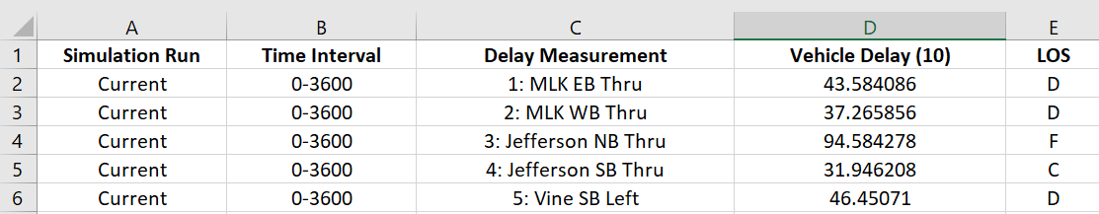

Case Study Simulated LOS using VISSIM
RET is funded by the National Science Foundation,
Grant # EEC-1710826
MLK Priority as Major Road

Slide 20

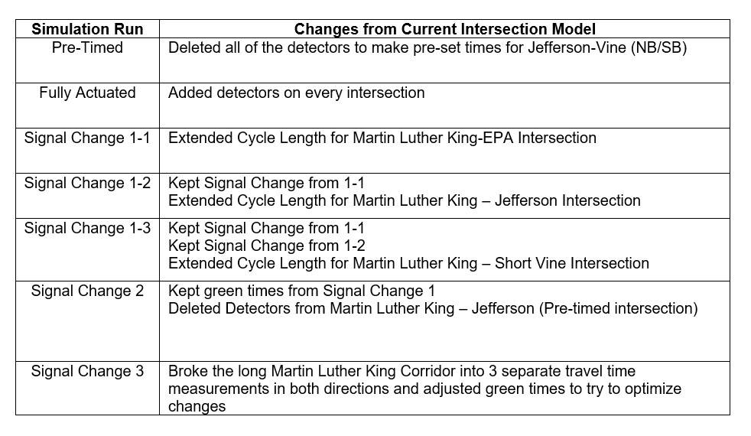
RET is funded by the National Science Foundation,
Grant # EEC-1710826
Proposed Alternatives: Signal Changes
Seven Simulation Run Changes

Slide 21
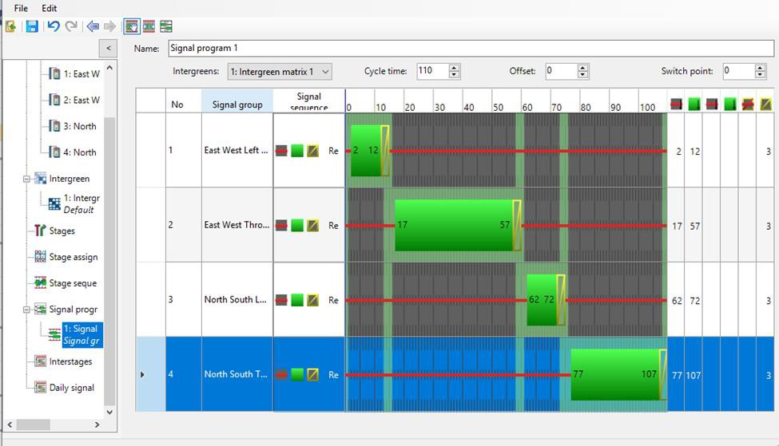
RET is funded by the National Science Foundation,
Grant # EEC-1710826
Proposed Alternatives:
Signal Changes
Cycle Length Changes

Slide 22
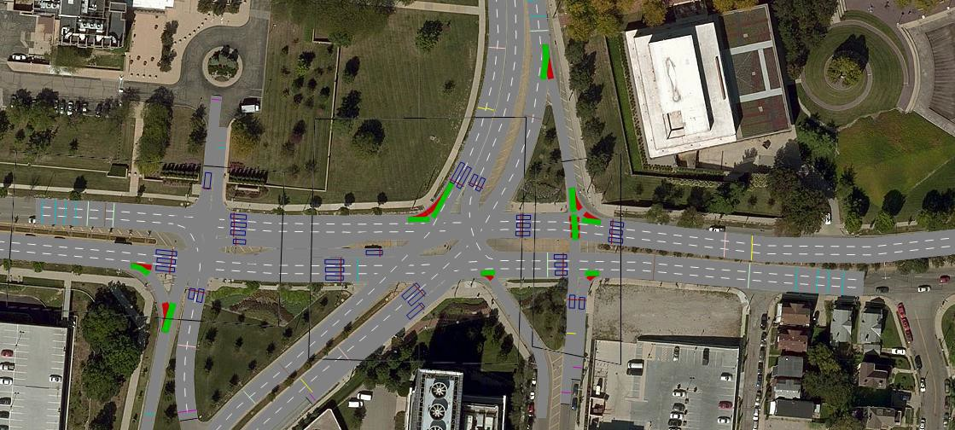
RET is funded by the National Science Foundation,
Grant # EEC-1710826
VISSIM Simulation of the Proposed Alternatives
Fully Actuated Signal

Slide 23


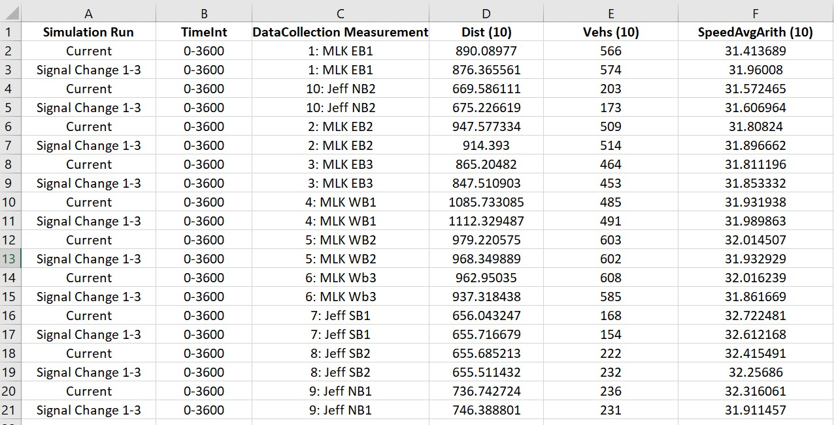
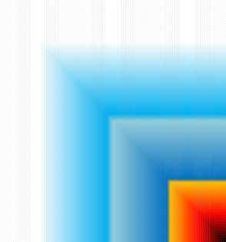
Analysis
of Simulation Results
RET is funded by the National Science Foundation,
Grant # EEC-1710826
Data Analysis Components

Slide 24



Analysis
of Simulation Results
RET is funded by the National Science Foundation,
Grant # EEC-1710826
Vehicle Delay Data
Vehicle Delay (10) on MLK EB Through Traffic
Roundabout Signal Change 2
Signal Change 1-3
Signal Change 1-2
Signal Change 1-1
Pre-Timed Fully Actuated
37.71
MLK
51.75
Signal Changes
37.80
39.60
44.48
70.01
40.89
0.00
Current
43.58
Vehicle Delay (10) on MLK WB Through Traffic
0.00
10.00 20.00 30.00 40.00 50.00 60.00
Average Delay in seoncds/vehicle
70.00 8
Roundabout 31.85 Signal Change 2
55.69
Signal Changes
Signal Change 1-3
Signal Change 1-2
Signal Change 1-1
Pre-Timed Fully Actuated
Current
36.59
36.14
38.80
Cars (10) – 98%
of traffic flow
58.78
37.01
37.27
30.00 40.00
0.00
10.00 20.00
50.00 60.00
70.00
Average Delay in seconds/value

Slide 25


RET is funded by the National Science Foundation,
Grant # EEC-1710826
Analysis of Simulation Results
Emissions Data
Emission Measures
Nitrogen Oxide
Carbon
Fuel
Consumption
Compounds
Sum of Volatile Organic Compounds by Simulation Run
Signal Change 1-3
3787.78
Signal Change 1-2
3839.93
Signal Changes
Signal Change 1-1
3843.19
Pre-Timed
3915.74
Fully Actuated
3831.25
Current
3782.27
3750.00 3800.00 3850.00 3900.00
Total Sum of Emission VOC in grams through all intersections
3700.00
3950.00

Slide 26

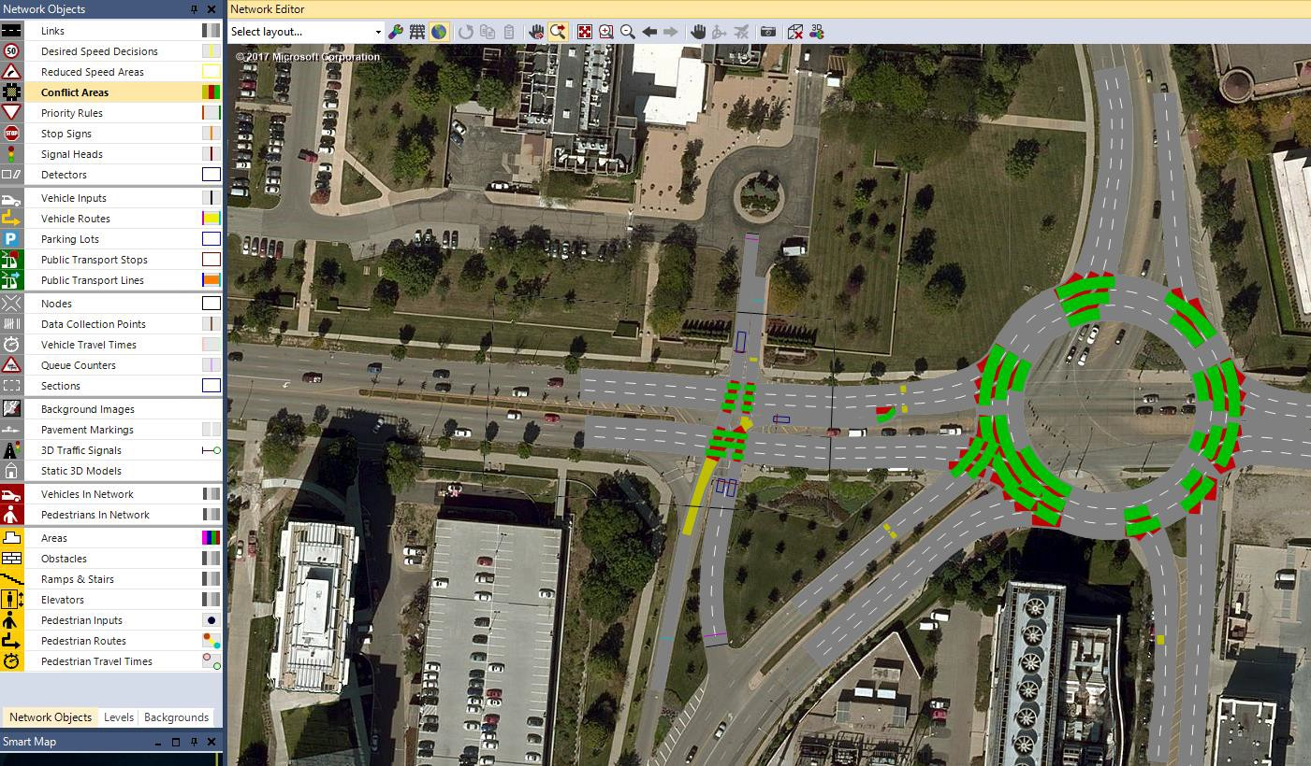

RET is funded by the National Science Foundation,
Grant # EEC-1710826
Proposed Roundabout
Three Lane Roundabout Simulation
Vine St
Challenge Visualizing Links & Connectors

Slide 27

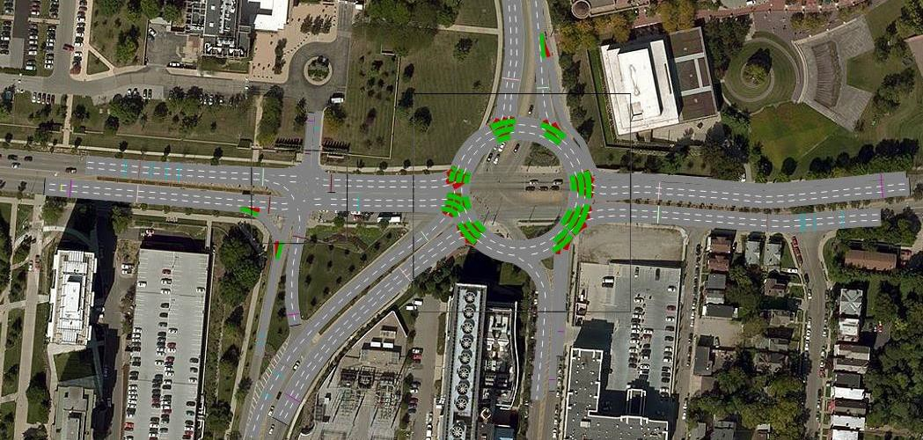

RET is funded by the National Science Foundation,
Grant # EEC-1710826
Proposed Roundabout
No Left Turns
Continuous Right Turn from MLK to Vine
Vine St

Slide 28
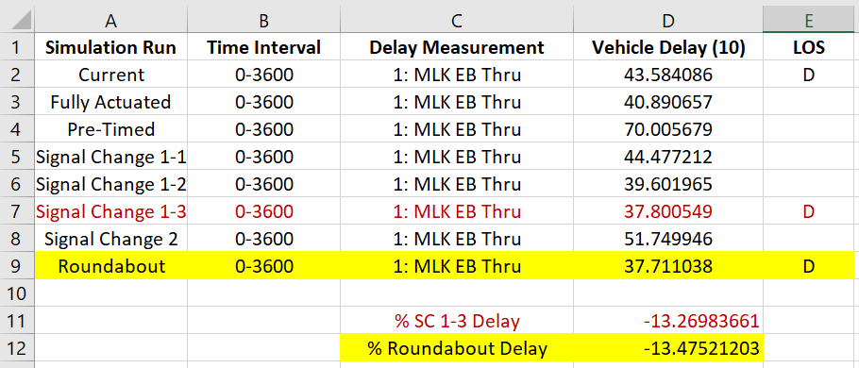




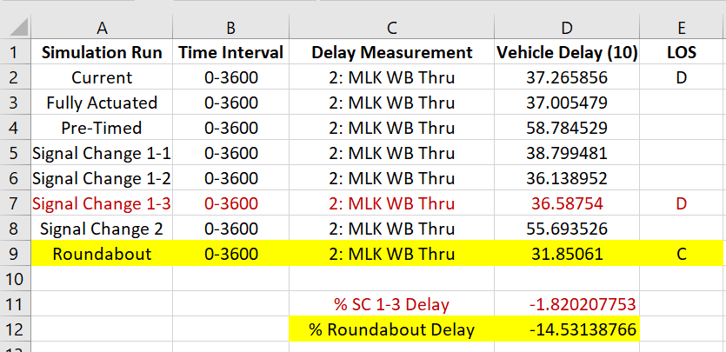
RET is funded by the National Science Foundation,
Grant # EEC-1710826
Final Recommendation
Simulation Signal Change 1 - 3
Delay
Reductions:
MLK EB – 13.3%
MLK WB – 1.8%

Slide 29
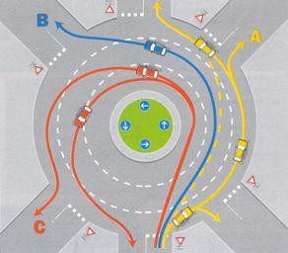
RET is funded by the National Science Foundation,
Grant # EEC-1710826
Roundabout or Not?
Limitations to Roundabout Simulation
Roundabout is most efficient under the condition of less than 600 vehicles/hour/lane
  Simulation vs. Real-life
    Extended Research before putting into
practice
      Non-intuitive Emission Data

Slide 30










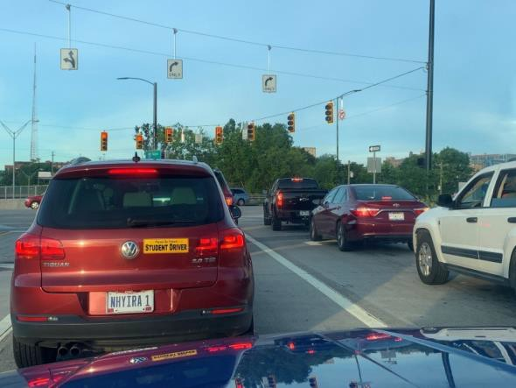


RET is funded by the National Science Foundation,
Grant # EEC-1710826
Efforts of Traffic Engineers
2017 U.S. GHG EMISSIONS BY SECTOR
Many Factors
Transportation Agriculture
Electricity Commercial
Industry Residential
6%
9%
5%
29%
22%
28%
Never Look at Traffic Signal the Same Again

Slide 31
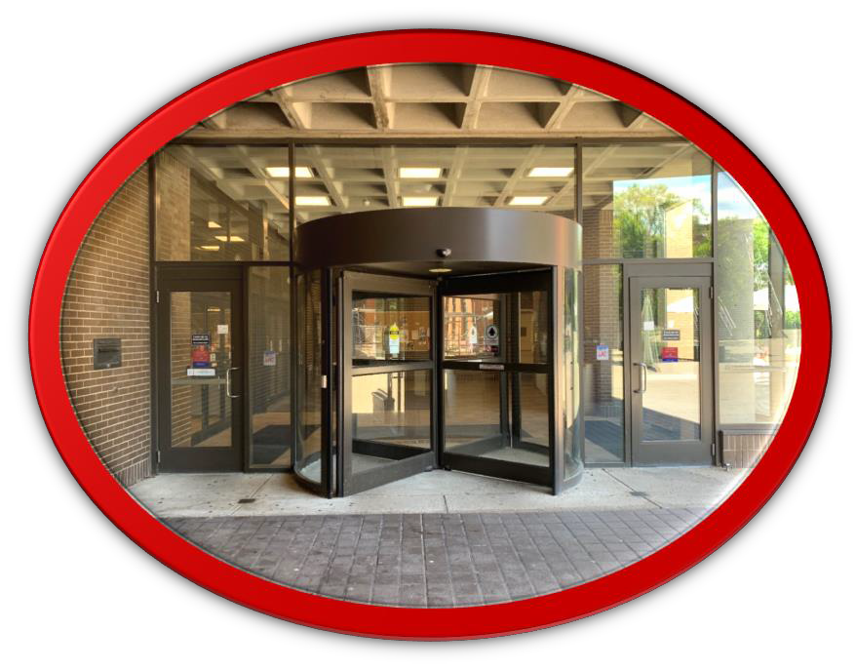
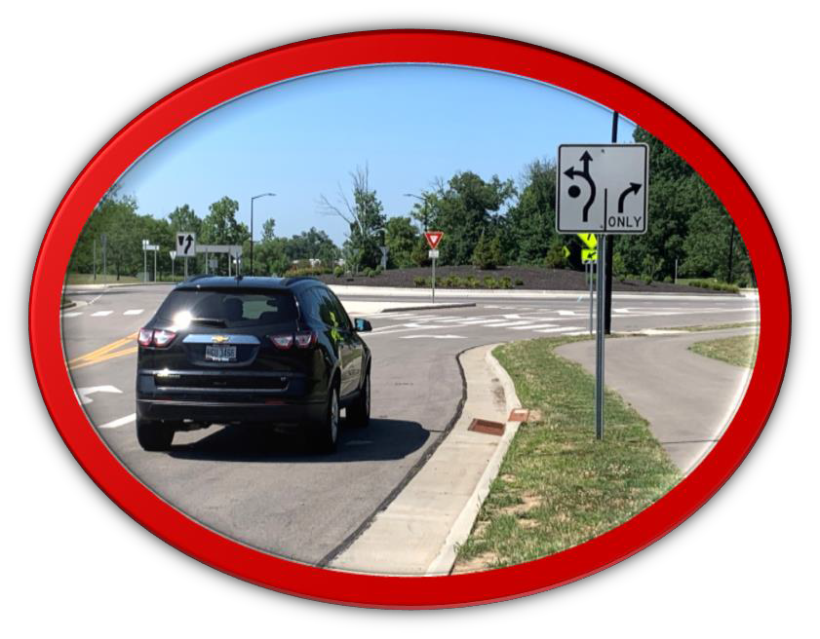

Class Implementation Plan: Lynn’s Geometry Class
RET is funded by the National Science Foundation,
Grant # EEC-1710826
The Big Idea
CIRCLES used in TRANSPORTING
Revolving Doors for People
Roundabouts for Cars

Slide 32


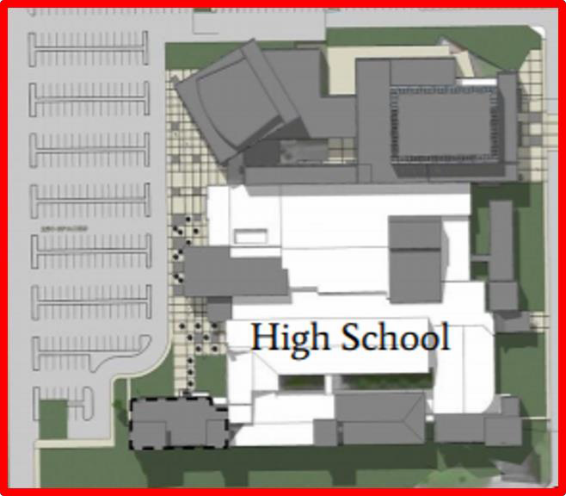
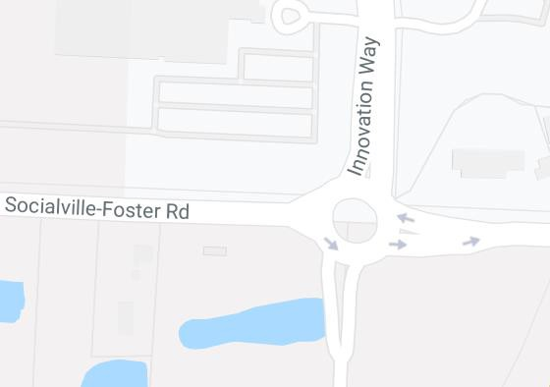
RET is funded by the National Science Foundation,
Grant # EEC-1710826
Class Implementation Plan: Lynn’s Geometry Class
The Hook
Essential Question
- Model an efficient revolving door for the new entrance to King HS

Slide 33

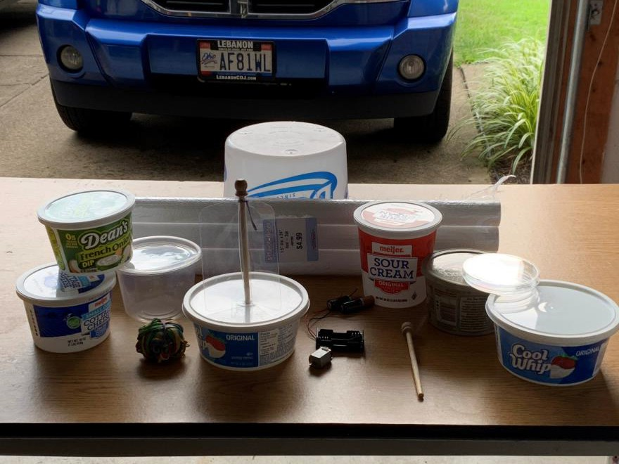

RET is funded by the National Science Foundation,
Grant # EEC-1710826
Class Implementation Plan:
Lynn’s Geometry Class
The Challenge
Challenge
  Build a scale model of a revolving door
  Efficiently move KHS students
  3-minute Sale Pitch

Slide 34

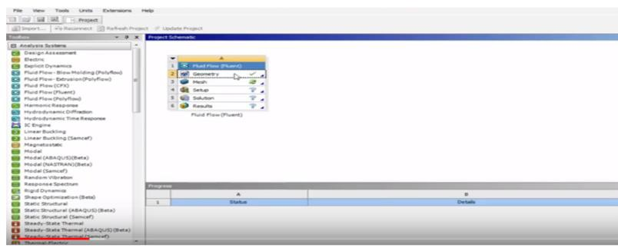
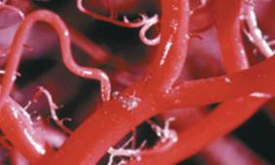
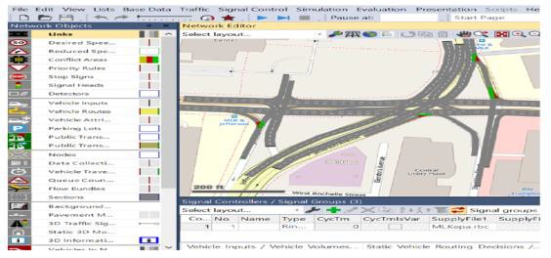
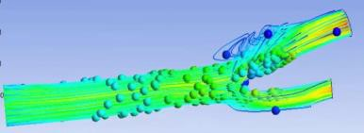

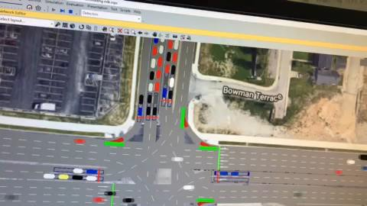
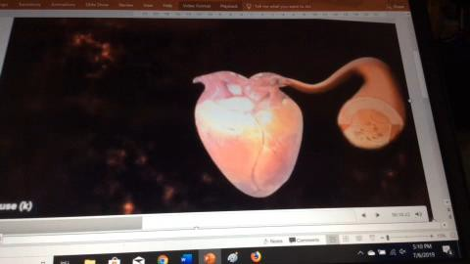
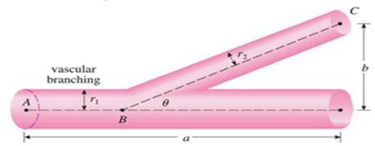
Class Implementation Plan:
Girija’s Calculus I Class
Optimizing the Energy Expended by Heart Muscles during Blood Trafficking at the Intersection of
Artery, Capillary, and Veins
Research Optimizing traffic flow at
the intersections
Classroom Application The Calculus Process of
Optimization
Benefits Application – real life connection- hands-on
C F D
Vissim 9.0

Slide 35
RET is funded by the National Science Foundation,
Grant # EEC-1710826
Acknowledgement
Dr. Heng Wei, Faculty Mentor
Mrs. Lora Buchanan, RET Program Coordinator Dr. Margaret Kupferle, RET Principal Investigator
Mrs. Pamela Truesdell, Instructor, Engineering Design Course
Mr. Raja Bharat Annam, Graduate Research Assistant Dr. Qingyi Ai, Industry Partner, Arcadis-US, Inc.
National Science Foundation
University of Cincinnati

Slide 36
RET is funded by the National Science Foundation,
Grant # EEC-1710826
References
Heart blood flow YouTube video
Highway Capacity Manual 2016
Manual on Uniform Traffic Control Devices 2009
Smithsonian Magazine
Traffic Signal Timing Manual
Vissim First-steps Manual

Slide 37
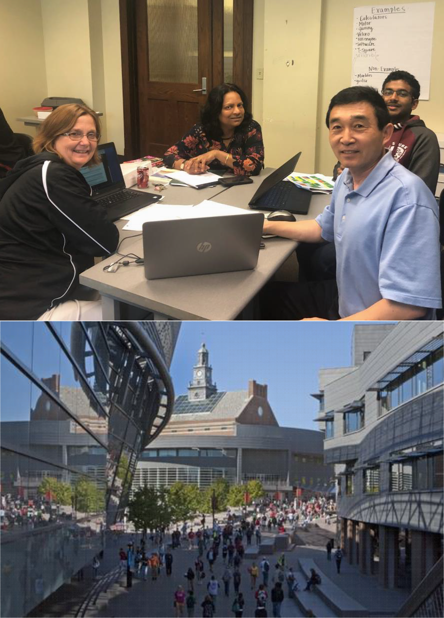


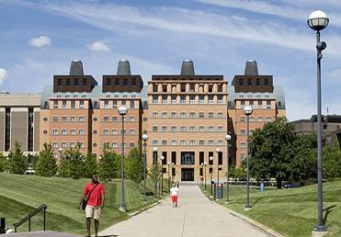

RET is funded by the National Science Foundation,
Grant # EEC-1710826
Thank you for attending today!
37

